Slide 1
Parallel Imaging Reconstruction Using Automatic Regularization
Jaeeun Lee
2018/08/24

Slide 2
Contents
Intro
Inter-channel noise whitening
Tikhonov Regularization
g-factor
L-curve

Slide 3
Regularization_1) Intro
SNR is reduced due to
1. the reduced number of data samples ; inevitable
2. correlation in the spatial info(geometrical arrangement of the array coil) ; optimizing coil geometry
We can mitigate the noise amplification in SENSE reconstruction by utilizing Tikhonov regularization.
The advantages of regularized parallel MRI reconstructions was reported in various studies.
- regularization can potentially be used to unfold aliased images from an underdetermined system
A Full-FOV reference scan and the L-curve algorithm was employed to determine the optimum regularization parameter in this study.
g-factor maps are also used to demonstrate the effect of regularization on the noise of the unfolded images.

Slide 4
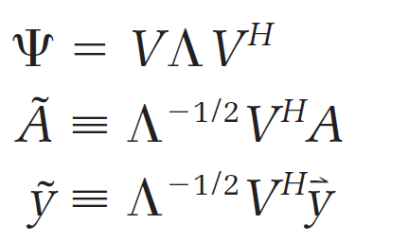
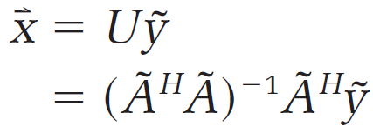
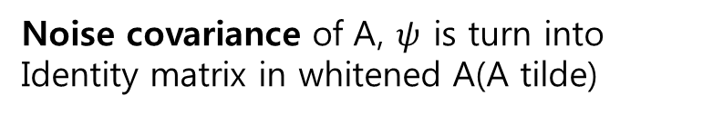

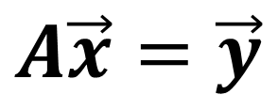
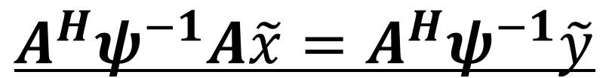

Regularization_2) Inter-channel noise whitening
$$A\vec{x}=\vec{y}$$
In general, A is an overdetermined linear system
[Nc x m]
$$\vec{x} :Full−FOV img$$
$$\vec{y} :Folded img of each receiver coil$$
$$A^{H}ψ^{−1}A\tilde{x}=A^{H}ψ^{−1}\tilde{y}$$
Phi : ‘noise’ covariance matrix
1) phi inverse decorrelate the inter-coil noise // role of V^{H}
2) give a relatively more weight on the coil which has low noise
variance value(means that coil is less noisy) // role of Λ^{-1/2}
$$ψ :the receiver noise covariance, [Nc x Nc]$$
-1
Whitening transformation
Noise covariance of A, $ψ$ is turn into
Identity matrix in whitened A(A tilde)

Slide 5




Regularization_3) Tikhonov regularization
L : positive semi-definite linear transformation
Regularization factor
prior information
model error
prior error
~
$$\tilde{y}$$

Slide 6
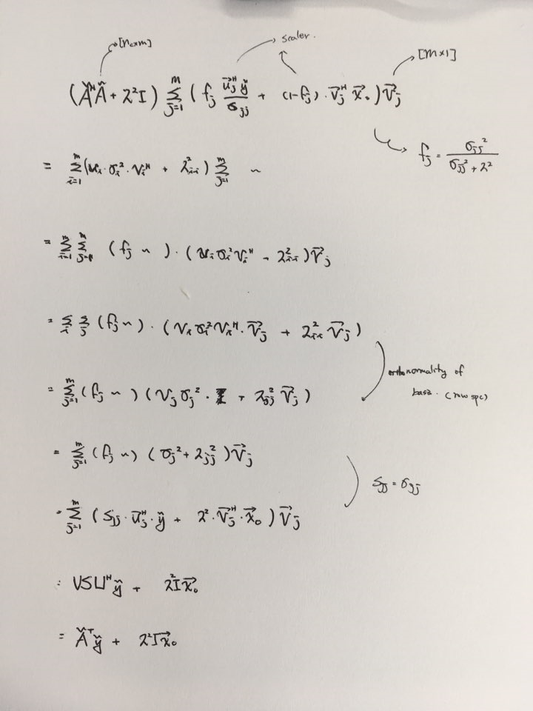
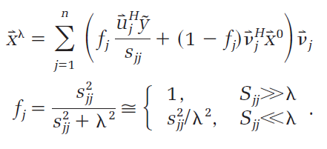
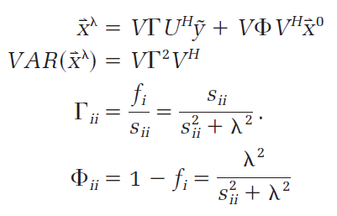
Regularization_3) Tikhonov regularization
proof

Slide 7
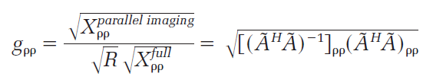
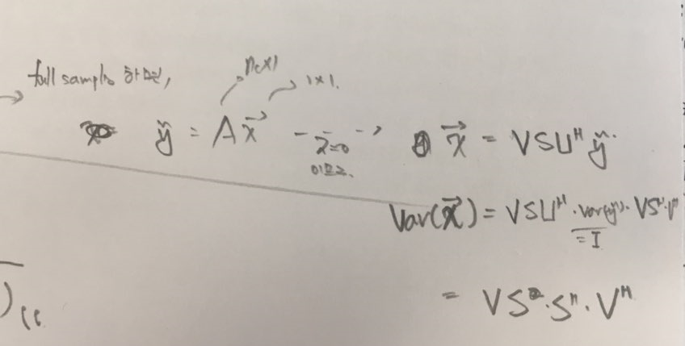

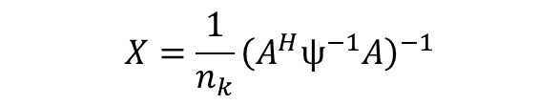
Regularization_4) g-factor
G-factor : quantified noise sensitivity
$$X=\frac{1}{n_{k}}{\left(A^{H}ψ^{−1}A\right)}^{−1}$$
$$X :covariance of the reconstruction image vector x$$

Slide 8
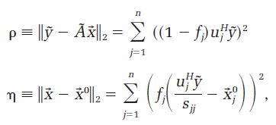
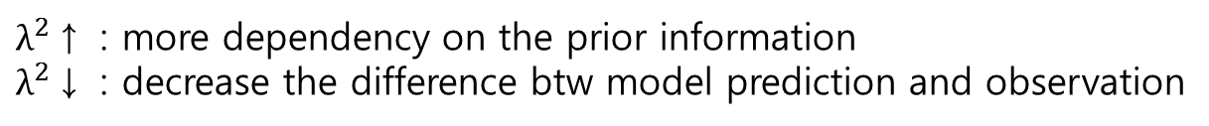
Regularization_5) L-curve
To determine the appropriate regularization parameter($λ^{2}$)
$λ^{2}$↑ : more dependency on the prior information
$λ^{2}$↓ : decrease the difference btw model prediction and observation

Slide 9
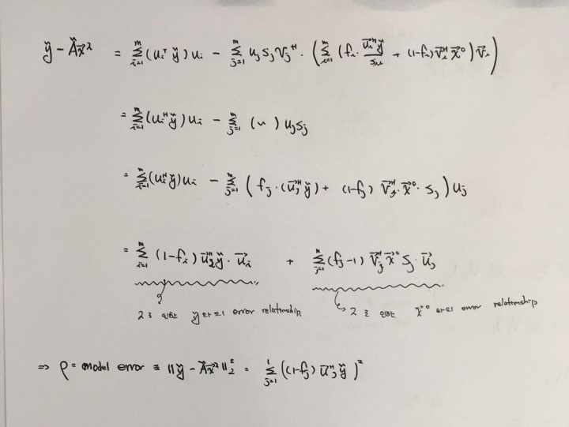
Regularization_5) L-curve

Slide 10
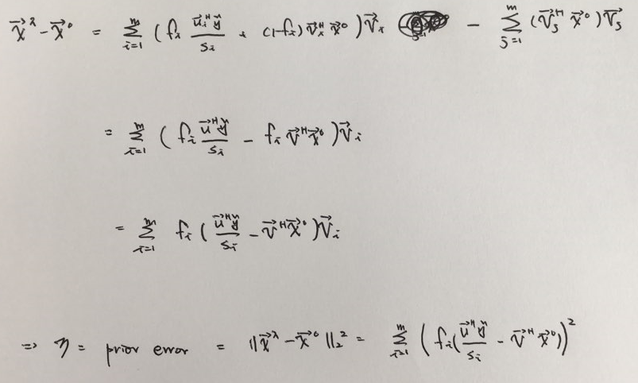
Regularization_5) L-curve

